Slide 1
Toy Horse Conjoint Analysis Team 18

Slide 2
Analysis Framework:
1. Cluster Analysis
2. Prior Segmentation
3. Market Simulation
Regression analysis by individual
Find the optimal number of clusters
Visualization: pie chart, cluster plot and coefficient histogram
Recommendation for each segment
Aggregate regression to find the average preference
Past-worth estimate
Priori segment level conjoint analysis by gender and age
Test variable effect
Translate into preferred product
Disaggregate analysis with a first choice rule
Forecast market share and profit in different scenarios
Current market
Competitor lowers price
Other scenarios: adjust to previous cluster analysis
Product Recommendation:
The two products that we recommend reflect preferences of 80% prospective consumers in the market.
Product 1 targets price sensitive bouncing lovers (50%) and product 2 targets glamorous horse lovers (30%), which are the two biggest segments from our conjoint cluster analysis.
As for gender, boys’ parents are more price-sensitive than girls’ parents, but they both prefer tall size toys. Boys generally prefer racing bouncing house, while girls prefer rocking glamorous horse.
Therefore, product 1 perfectly targets parents of boys and product 2 targets parents of girls.
Product 1: $119.99, 26’ Racing Bouncing Horse
Product 2: $139.99​, 26’ Glamorous Rocking Horse
Scenario | Market Share | Profit
Competitor price at $139.99 | 94.1% | $217,398.4​
Competitor price at $119.99 | 69.9% | $150,472​

Slide 3

Segment Portrait Based on Part-Utilities
Price-Sensitive Bouncing Lovers
Price: 22.4 They are very sensitive to price compared to the other segments.
Height: 5.1 They moderately prefer larger size.
Motion: -9.8 They are passionate bouncing horse lovers.
Style: -6.5 They are the only group into racing style.
50% 30% 20%
Glamorous Horse Lovers
Intercept: 43.1 People in this group love toy horse the most.
Price: 8.8 They respond the least to price change compared with other two groups.
Height: 16.5 They care about tall size the most among other features of toy horse.
Motion: 7.2 They are passionate bouncing horse lovers.
Style: 11 They have strong preference for glamorous style.
Rocking Horse Lovers
Price: 12 They care about price the most among other features but are less price-sensitive compared to bouncing lovers.
Height: -6.5 They have special preference to small-sized toy horse compared the other two groups.
Motion: 9.7 They are passionate rocking horse lovers.
Style: 0.1 They don’t show an obvious preference to style

Slide 4
Product Recommendation Based on Part-Utilities
Price-Sensitive Bouncing Lovers Glamorous Horse Lovers Rocking Horse Lovers
Product recommended:
$119.99
26’’ Racing Bouncing Horse
Reasons:
This segment is highly price-sensitive, so we offer a lower price in order not to shut them out.
We offer bouncing and racing features that cater to their preference with correspondingly low cost.
Although 26’’ toy horse costs more, considering the size of the segment (50% of market), it is important to win this segment by offering their “perfect choice”.
Product recommended:
$139.99
26’’ Glamorous Rocking Horse Reasons:
We set a higher price for this segment because they are less price-sensitive while valuing other two features of toy horse over price. (We expect a high WTP here)
We customize 26’’ glamorous rocking horse to provide an “ideal product” that perfectly match their preference.
Although cost of 26’’ rocking horse is higher, the high margin is expected to win us profit.
Product recommended:
$119.99
18’’ Glamorous rocking Horse
Reasons:
Although this segment is less price-sensitive, since price is the feature they care the most about toy horse, so by intuition, we do not risk losing the consumer by setting a high price. (*will simulate the scenario with high price later)
We offer 18’’ glamourous toy to target this segment with correspondingly low cost.
We offer rocking horse regardless of the high cost to suit their special preference.

Slide 5
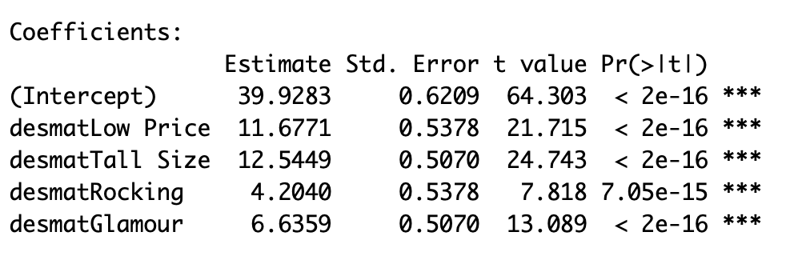
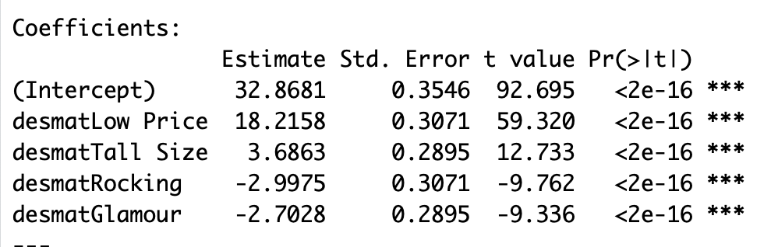
Segment Portrait Based on Gender
Gender = Female
Gender = Male
Findings:
Parents of girls are less price sensitive to price compared to parents of boys.
Parents of girls and boys both prefer Tall Size toys, but it is much more important for parents of girls.
Parents of girls prefer Rocking toys, while parents of boys prefer bouncing toys.
Parents of girls prefer Glamourous style, while parents of boys prefer Racing style.

Slide 6
Product Recommendation Based on Gender
For Parents of Girls
For Parents of Boys
Product recommended:
$119.99
18’’ Racing Bouncing Horse
Reasons:
They are more price sensitive, lower price will generate more sales volume.
They prefer bouncing horses, which have lower variable cost, so lower price will not reduce marginal contribution.
Though they prefer tall size, the coefficient is smaller than girls segment, also smaller than low price coefficient. To maintain our marginal contribution, we should provide them smaller size horses, which have lower variable cost, with lower price.
They don’t like glamour style horses.
Product recommended:
$139.99
26’’ Glamorous Rocking Horse
Reasons:
They are less price sensitive, so price can be higher.
They prefer rocking horses, which have higher variable cost, so price should be higher.
Higher horses have higher variable cost, so price should be higher.
They prefer glamour style horses.

Slide 7
Market Simulation – Market Share and Profits
Scenario | Products | Market Share | Profits of Firm
Scenario 0 (currently) | Firm: 18’’ /Glamorous /Rocking /$139.99 18’’ /Racing /Rocking / $139.99 Competitor: 26’’ /Racing /Rocking /$139.99 | Firm: 0.154+0.21 Competitor: 0.636 | 75,009.44
Scenario 1 | Firm: 18’’/ Glamorous/Rocking/$119.99 26’’ /Racing /Bouncing /$119.99 Competitor: 26’’ /Racing /Rocking /$139.99 | Firm: 0.74+0.15 Competitor: 0.11 | 186,644.4
Scenario 2 | Firm: Same as Scenario 1 Competitor: 26’’ /Racing /Rocking /$119.99 (decreases price) | Firm: 0.415+0.025 Competitor: 0.56 | 71,262.4
Scenario 3 | Firm: 18’’/ Glamorous/Rocking/$139.99 26’’ /Racing /Bouncing /$119.99 Competitor: 26’’ /Racing /Rocking /$139.99 | Firm: 0.15+0.726 Competitor: 0.124 | 201,933
Scenario 4 | Firm: Same as Scenario 3 Competitor: 26’’ /Racing /Rocking /$119.99 (decreases price) | Firm: 0.027+0.517 Competitor: 0.456 | 107,066.2
* We tried two products we recommended for Price-Sensitive Bouncing Lover and Rocking Horse Lover in scenario 1 and scenario 2 (different responses of competitor). Because we are not sure about the price for Rocking Horse Lover, we tried a higher price for 18’’/ Glamorous/Rocking in scenario 3 and scenario 4, and it works better.
Notes:
0: 13,5 /7
1: 13,4 /7
2: 13,4 /8
3: 15, 4/7
4: 15,4 /8
5:15,4,13/7
6:15,4,13/8
改了1和2
1对应code里的8，
2对应code里的11
后面对应的都要减2

Slide 8
Market Simulation – Market Share and Profits
Scenario | Products | Market Share | Profits of Firm
Scenario 5 | Firm: 26’’ /Glamorous /Rocking /$139.99 26’’ /Racing /Bouncing /$119.99 Competitor: 26’’ /Racing /Rocking /$139.99 (what if $119.99) | Firm: 0.328+0.613 Competitor: 0.059 | 217,398.4
Scenario 6 | Firm: Same as Scenario 5 Competitor: 26’’ /Racing /Rocking /$119.99 (decreases price) | Firm: 0.198+0.501 Competitor: 0.301 | 150,472
Scenario 7 | Firm: 26’’ /Glamorous /Rocking /$139.99 26’’ /Racing /Bouncing /$119.99 18’’/ Glamorous/Rocking/$139.99 Competitor: 26’’ /Racing /Rocking /$139.99 | Firm: 0.291+0.559+0.117 Competitor: 0.033 | 209,389.3
Scenario 8 | Firm: Same as Scenario 7 Competitor: 26’’ /Racing /Rocking /$119.99 (decreases price) | Firm: 0.198+0.501+0.025 Competitor: 0.276 | 138,371
*Then we tried products recommended for Price-Sensitive Bouncing Lovers and Glamorous Horse Lovers in scenario 5 and 6. This combination performs well. In scenario 7 and 8, we tried a combination of three products targeted at three segments. It seems that higher fixed cost have a bad influence on total profits.

Slide 9
Marketing Plans
Competitor Not Cut Price
Competitor Cut Price
Final Product Line: 26’’ / Glamorous / Rocking at $139.99
26’’ / Racing / Bouncing at $111.99
Our product line is above with the condition that competitor does not cut price, and we can achieve 94.1% market share with $217,398 profit.
We will promote our first Glamorous product to Glamorous Horse Lovers who are less price sensitive and prefer glamorous product .
Focus on Glamorous Feature.
Our product line is the same as the competitor cut price, and we can achieve 69.9% market share with $150,472 profit.
Since $111.99 type will bring more customers. We will heavily promote this type to Price-Sensitive Bouncing Lovers.
We will market our product’s bouncing feature with large size and reasonable price compared to competitor.

Slide 10
Insights:
Product 1: 26’ Racing Bouncing Horse, $119.99
Product 2: 26’ Glamorous Rocking Horse, $139.99​
There are three consumer segments in the market who have significantly different preferences.
We should consider sales and cost tradeoff when catering to consumers' high-cost preferences.
The ‘Price-Sensitive Bouncing Lovers’ segment is highly price-sensitive and takes up 50% of the market, so we need to lower our price to satisfy their needs.
The other two segments ‘Glamorous Horse Lovers’ and ‘Rocking Horse Lovers’ prefer costly product features. According to market simulation results, price high here is more profitable than price low.
Competitor cutting price significantly affects our market share and profits, so we should consider competitor reaction when setting prices.
Expanding product lines increase our market share, but it does not guarantee larger profits.
Based on consumer preference of two segments, the glamorous and rocking feature should be bundled together, while the racing and bouncing attribute should be a set.
Price-Sensitive Bouncing Lovers
Glamorous
Horse
Lovers
Rocking Horse Lovers
Current Problems:
Currently, both our products are priced at $139,99, which costs us huge market share loss.
Besides, both products are all of the small 18’ size, but 80% of people prefer tall size toys.
Future Marketing Plan:
When promoting the two recommended products, we can focus on the low price and Bouncing feature for product 1, and the Glamorous and Rocking feature for product 2.
Also, we can target boys’ parents by leveraging more on product 1’s Racing and Bouncing feature, while targeting girls’ parents by emphasizing product 2’s Glamorous and Rocking feature. This also provides inspiration for further advertising design.

Slide 11
Appendix

Slide 12

(Alternative): Segment Portrait Based on Conjoint Part-Utilities
Segment 1:
Intercept: 41 People in this group have great interest in buying toy horse.
Price: 10.1 They care price over other features of toy horse, but are less price-sensitive compared with segment 2.
Height: 7.5 They love tall size more than segment 2.
Motion: 8.2 They are passionate rocking horse lovers.
Style: 6.7 They have strong preference for glamorous style.
Segment 2:
Intercept: 29 People in this group have less interest in buying toy horse compared to segment 1.
Price: 22.4 They care price way more than other features of the toy, and are highly price-sensitive compared to segment 1.
Height: 5.1 They also love tall size but less than segment 1.
Motion: -9.8 They are passionate bouncing horse lovers.
Style: -6.5 They have strong preference for racing style
50% 50%
The two segments differ the most in motion and style, but share much similarity in size and less in price.

Slide 13
(Alternative): Product Recommendation Based on Part-Utilities
Segment 1 Segment 2
Product recommended:
$119.99/$133.99??
26’’ Glamorous Rocking Horse
Reasons:
We offer 26’’, glamorous and rocking attributes that cater to their preference, but the cost is relatively high.
The trickiest part is setting the price. We can price low to generate more sales since this segment responds most actively to price compared to other attributes, but this will lead to low margin.
We can also price high to cover the cost but the sales volume can not be guarantee. (considering the size of the segment accounts for 50% of the whole market)
What is told by this segment is too vague to make an optimized decision and many tradeoffs should be considered.
Product recommended:
$119.99
26’’ Racing Bouncing Horse
Reasons:
This segment is highly price-sensitive, so we offer a lower price in order not to shut them out.
We offer bouncing and racing attributes that cater to their preference with correspondingly low cost.
Although 26’’ toy horse costs more, considering the size of the segment (50% of market), it is important to win this segment by offering their “perfect choice”.

Slide 14
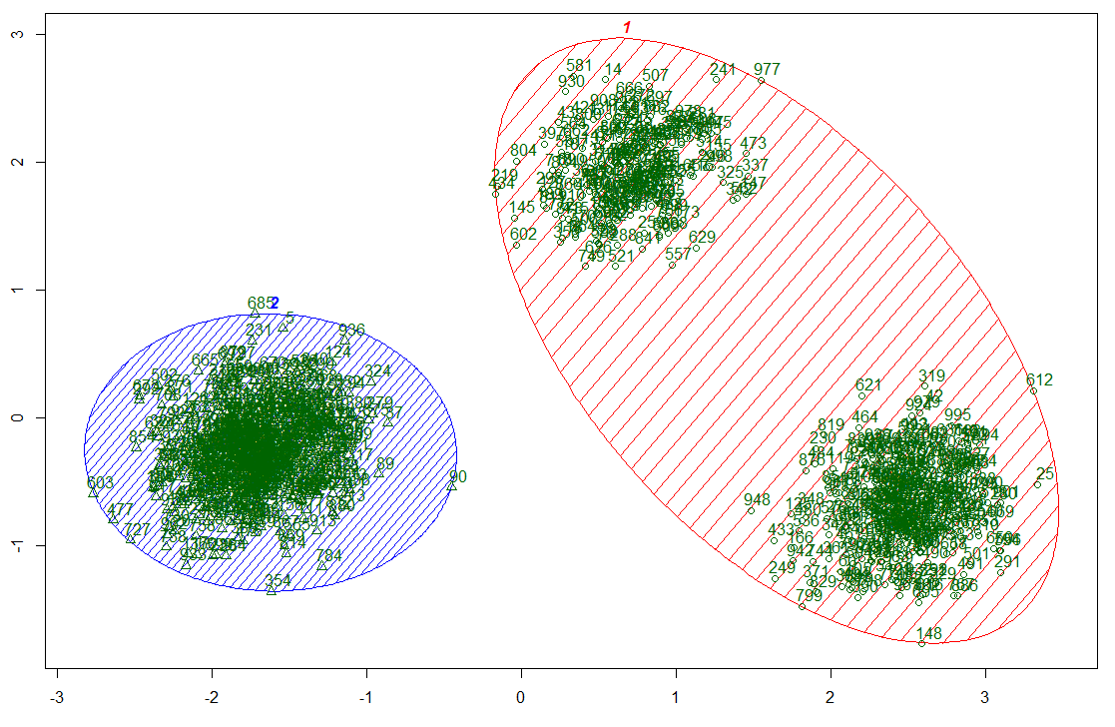
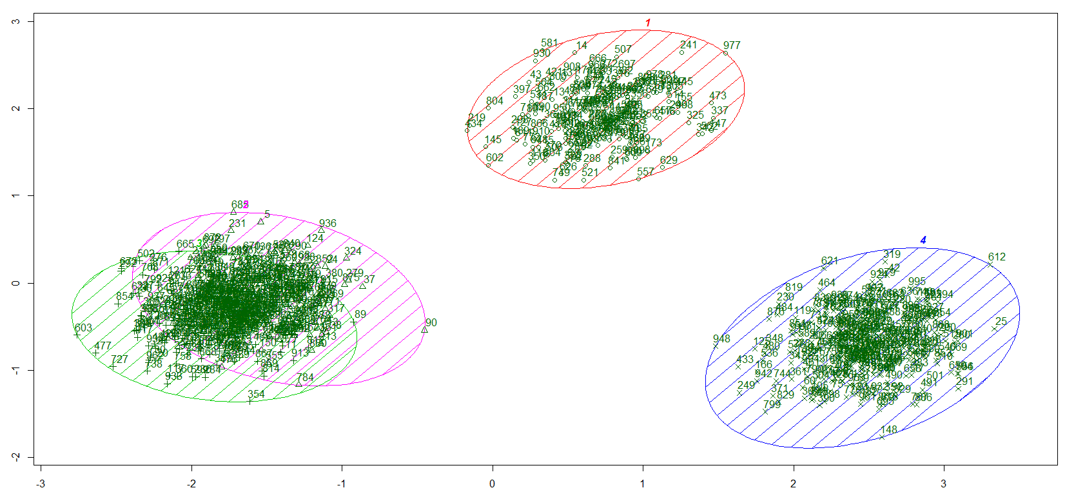
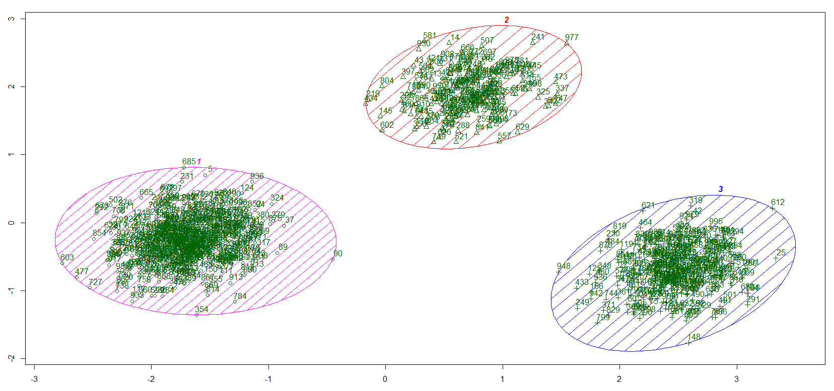


Rational Behind Selecting the Chosen Segmentation
We tried three different clustering approaches: cluster = 2, cluster = 3, cluster = 4
cluster = 2 cluster = 4 cluster = 3
When cluster = 2, we can observe the cluster on the right has two detached centers with points gathering around. This approach violates the “homogeneity within, heterogeneity in between” principle with one cluster having huge heterogeneity within itself.
When cluster = 4, we can observe the two clusters on the bottom left overlap a lot. This approach violates the “homogeneity within, heterogeneity in between” principle with two clusters sharing huge homogeneity and little heterogeneity from each other.
When cluster = 3, the segments are best represented by three clusters. (*Been technically tested with PCA)

Slide 15
Rational Behind Selecting the Chosen Segmentation
We tried three different clustering approaches: cluster = 2, cluster = 3, cluster = 4
Specifically, when we compare the mean coefficients of the alternatives to our chosen clustering approach. We can observe that:
When cluster = 3, we can find that segment 2 and segment 3 have totally different preferences for motion and style. But it is not told when cluster = 2. This clustering approach fails to capture the different conceptions of existing two segments on two important attributes.
When cluster=4, the first two segments are pretty similar in their preferences for horse toy on each attributes. Customizing multiple product lines for segments which are not so distinctive is both costly and meaningless.

Slide 16
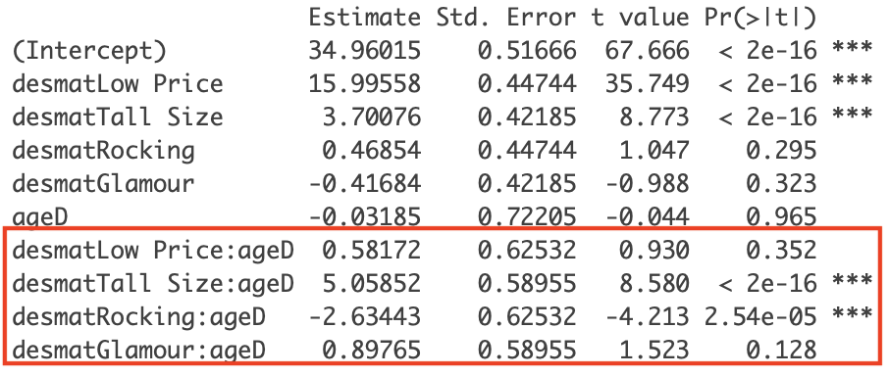
(Alternative): Prior Segmentation by Age
The highlighted data tells only the tall size factor and the rocking/bouncing factor are statistically significant. Among these 2 factors, tall size factor can vary from 3.9 to 6.2, while the coefficient of rocking/bouncing can vary from -1.4 to -3.9. Comparing the result of gender segmentation, age segmentation is not as effective as gender.

